Slide 1
A Sustainable Planet
Week 7
Industrial minerals
Fossil fuels
Dr Vicky Coker
Department of Earth and Environmental Sciences
vicky.coker@manchester.ac.uk; Williamson Building

Slide 2




Learning outcomes
Industrial Minerals
Identify different building materials and their sources
Explain cement and glass production
Describe the formation, mining, and uses of diamonds, gold, and rare earth elements
Fossil Fuels
Explain the carbon cycle and fossil fuel formation
Define coal types and extraction methods
Describe oil and gas formation, geological settings, and extraction techniques

Slide 3
Untreated rock products
-building stones and aggregates

Slide 4

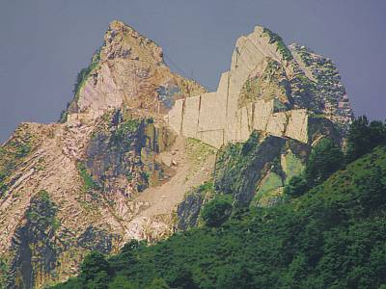
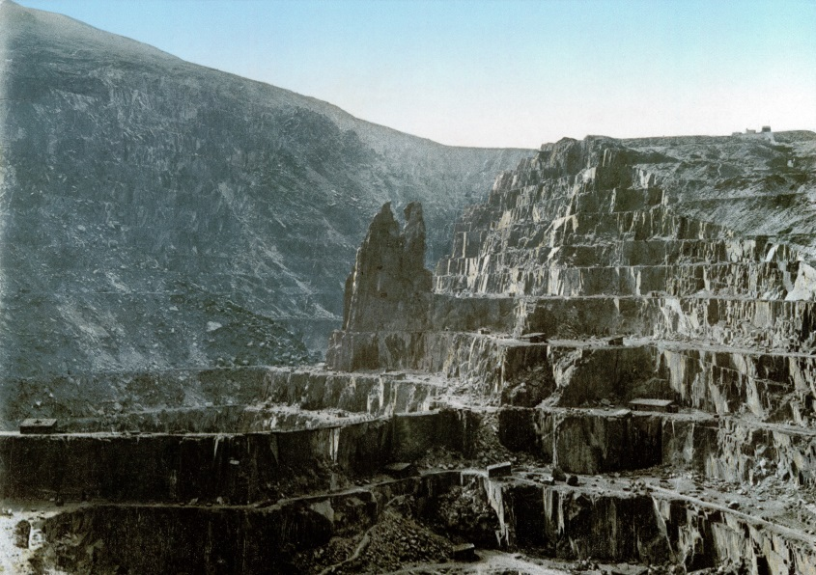
Building stone
Hotel Britannia, Manchester
Sandstone ashlar, with granite base
Granites-coarse grained and hardwearing
Sandstone -quartz and feldspar
Limestone/Dolomite –CaCO₃-MgCO₃
Marble –metamorphosed limestone
Slate –clays compressed during metamorphism
Carrara Marble Quarry, Italy
Penrhyn Slate Quarry, Wales

Slide 5
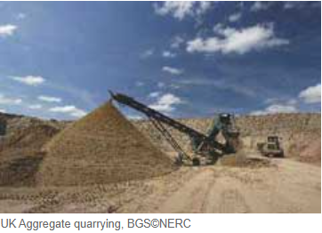
Crushed Rock = Aggregates
Largest volume hard-rock mineral commodity
Building foundations and road building
Easy to mine and crush but hard and inert
Most countries have a plentiful supply
Mined openpit in quarries

Slide 6
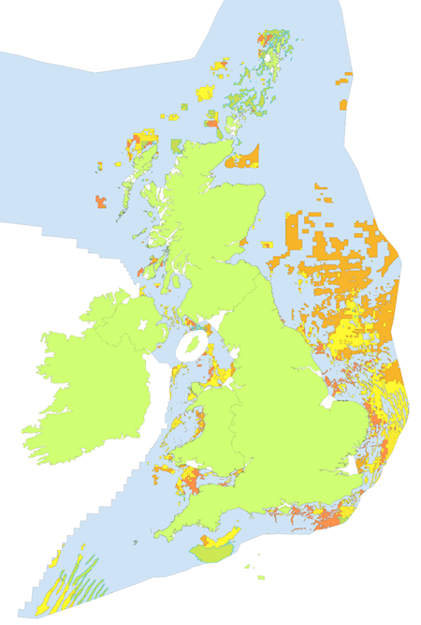
Sand and Gravel
Used in concrete production and road building
Weathered or abraded by glaciers from parent rock and transported by water
Found in river channels, their floodplains and alluvial fans and glacial deposits
e.g. off the continental shelf
Exploited through dredging
Sand and gravel resources of the UK continental shelf-The Crown Estate

Slide 7
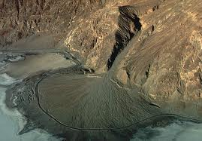
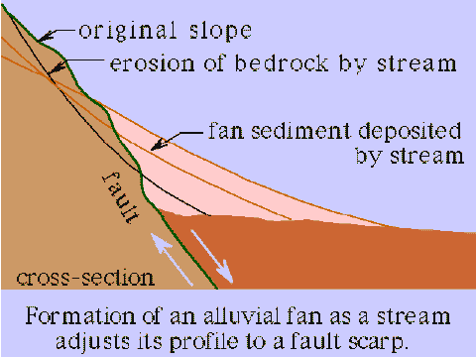
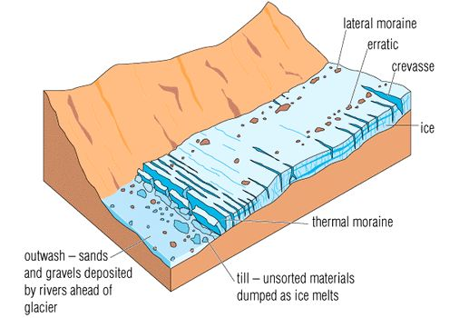
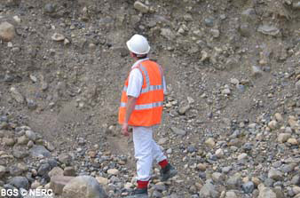
Alluvial deposits
edtech.mit.edu/fcgi-bin/pgt?part=1.0.4.1&img=1
Glacial deposits
https://www.bgs.ac.uk/Planning4Minerals/Resources_3.htm

Slide 8
treated rock products

Slide 9
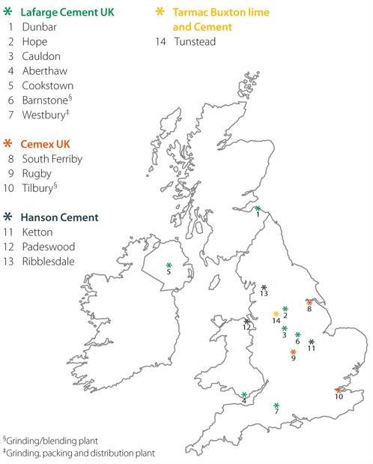
Cement
Chemical binder
Mixed with sand to make mortar
Mixed with sand and gravel to make concrete
Portland cement:
  Lime – CaO (from limestone)
  Alumina - Al₂O₃ (from shale or clay)
  Silica – SiO₂ (from clay, shale or sand)
  Gypsum/Anhydrite – CaSO₄(.2H₂O)
Cement plants are normally located near limestone quarries

Slide 10
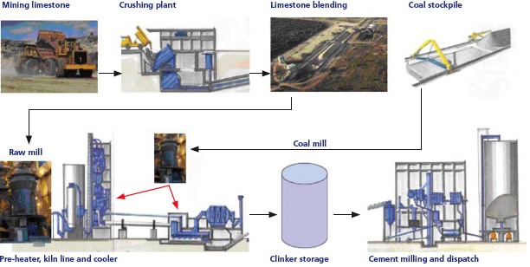
Cement production process
Sinter at 1500°C to produce CaO
(releases /removes CO₂ and H₂O)
Clinker milled and mixed with gypsum (controls setting time of cement)
Limestone
Alumina
Silica

Slide 11
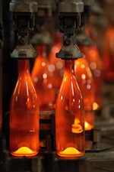

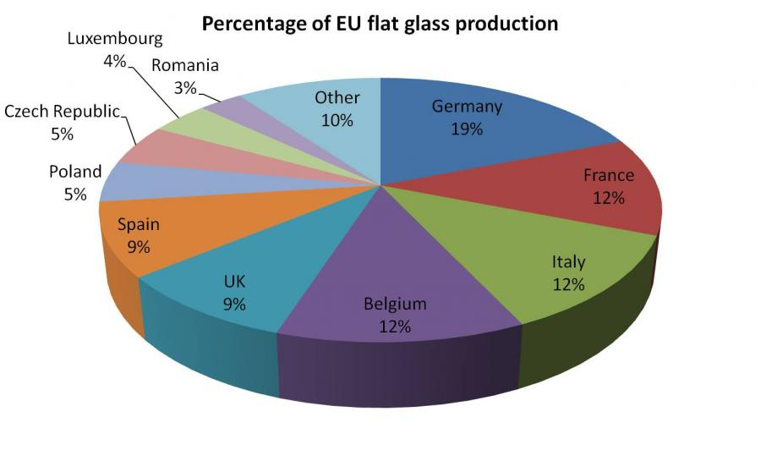
Glass
Melt together minerals that can be cooled in such as way that they do not form an organised arrangement of atoms
Annealed – slow cooling
Components:
  Silica (SiO₂) –high melting temp. 1713°C
  Soda (Na₂O) often added to reduce melting temp to ~500°C
  Lime (CaO) added to increase durability of soda glass
  Alumina (Al₂O₃) added to improve chemical resistance
Representation of atoms in glass
2008
http://www.glassforeurope.com/en/industry/index.php

Slide 12
Other industrial minerals

Slide 13



Diamond – an abrasive
Dense form of carbon
Cut, grind and polish all the modern alloys and ceramics
Hardest known material
80% of natural diamonds are used in industry e.g. diamond saws
Other abrasives include corundum and garnet
Diamond crystal structure
Graphite crystal structure
Notes:
Used as abrasives, drill bits, glass cutters
Only about 20% are gem quality

Slide 14
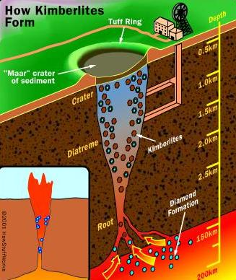
Kimberlite pipes
Diamonds form at:
  high pressures (above 30 kb) at depths of 150 km
  high temperatures (1000°C)
Kimberlites = igneous rocks highly enriched in magnesium and volatiles (CO₂ and H₂O)
Originate in the Earth’s mantle (150+ km depth)
Form ‘pipes’ as magma transports diamonds to the surface
Also form in Lamproite pipes (shallower deposits) and at the site of asteroid impacts (Popigai, Russia)
Secondary deposits = diamond placers

Slide 15
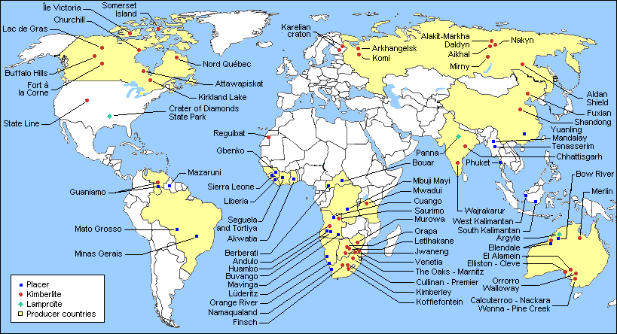
Of the kimberlites discovered to date, only 3% are significantly diamondiferous (i.e., containing macrodiamonds at a grade >1 carat per hundred tons)
Less than 100 kimberlites have been commercially mined for diamonds
https://www-elementsmagazine-org.manchester.idm.oclc.org/kimberlites-from-deep-earth-to-diamond-mines/

Slide 16
GOLD

Slide 17
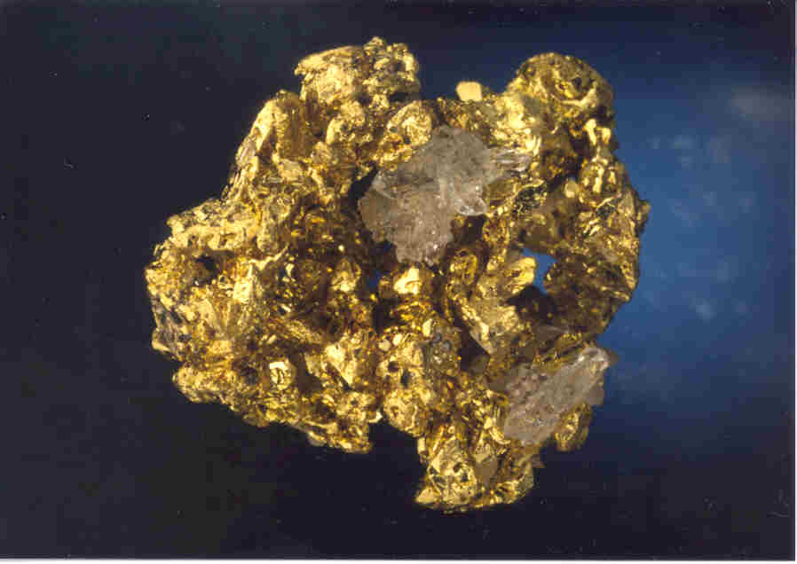

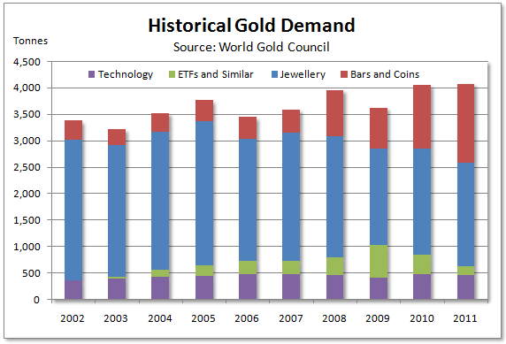
Gold
Corrosion and chemical resistant
Most of the gold mined is still in use today-durable
First used in ornamentation
Rarity = value for monetary purposes
Now used in aerospace, electronics, jewellery and special alloys

Slide 18
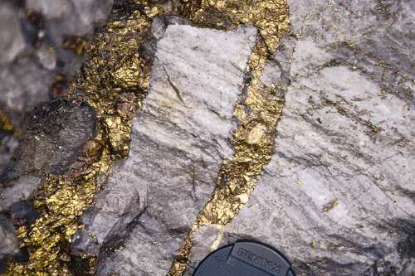
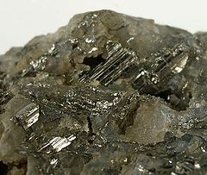
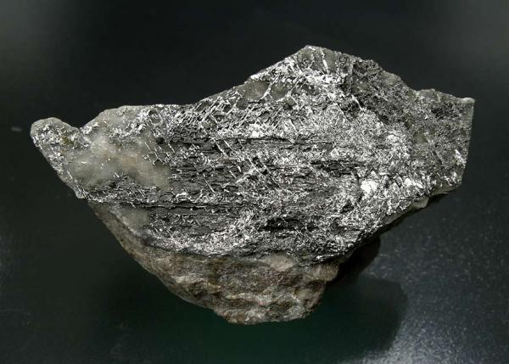
Gold deposits
Gold
Two main types:
  Hydrothermal
  Placer
Minerals
  Native gold –most abundant
  Calaverite AuTe₂
  Sylvanite (AuAg)Te₂
Calaverite
Sylvanite

Slide 19
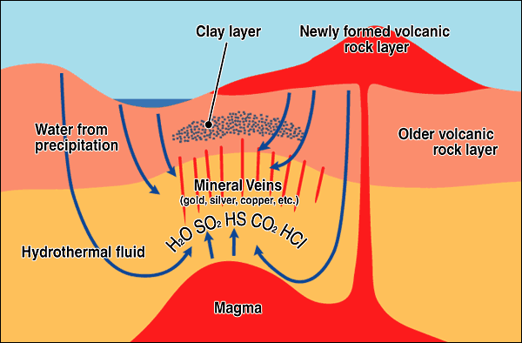
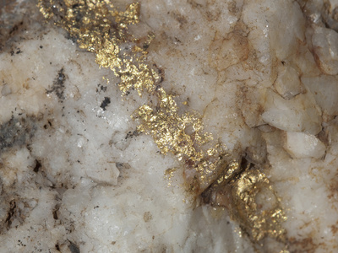
Hydrothermal Au deposits
Hydrothermal veins formed often in close association with granitic intrusions
Gold-bearing hydrothermal solutions move along fractures in rocks and cooling/changing pressure/mixing fluids occurs
Au deposits form in veins associated often with quartz+sulfide minerals
Often v. small
Can be found as lower grade deposits
  Hot springs
  Cu porphyries

Slide 20
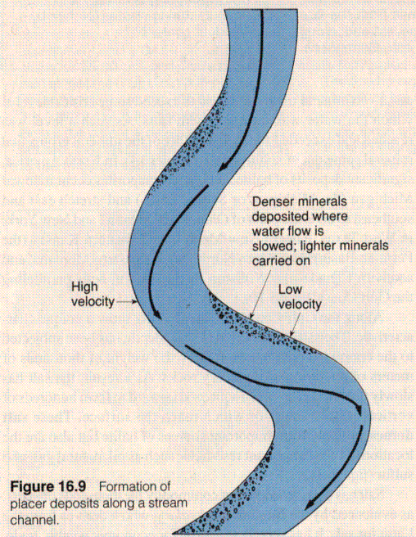
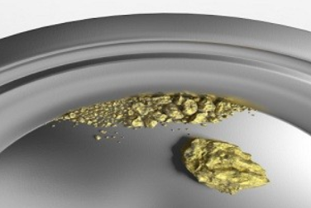
Gold placer deposits
Gold is weathered out from primary deposits
Concentrated through density by flowing water
These alluvial deposits created the California Gold rush in 1849

Slide 21
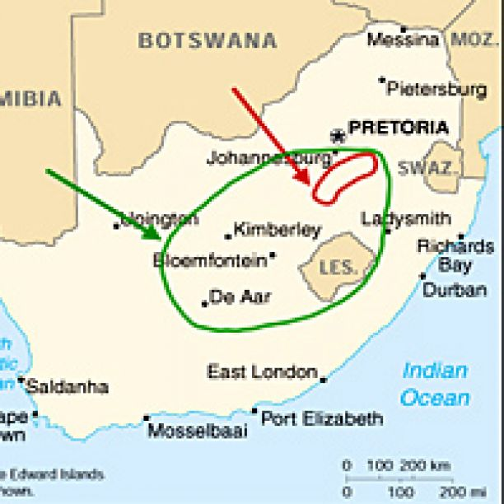
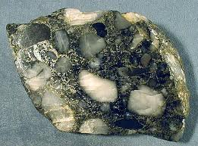
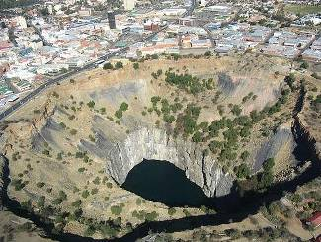
Witwatersrand Au deposits
Au fields
South Africa 1886
Ancient placers
Formation
  Conglomerates laid down in a shallow marine basin (2.3-2.8 billion years ago)
  Brought in by rivers from unknown primary sources in low oxygen conditions.
  Associated with pyrite and uranium deposits
One of the worlds deepest mine 3.5 km
Old gold mines, South Africa

Slide 22
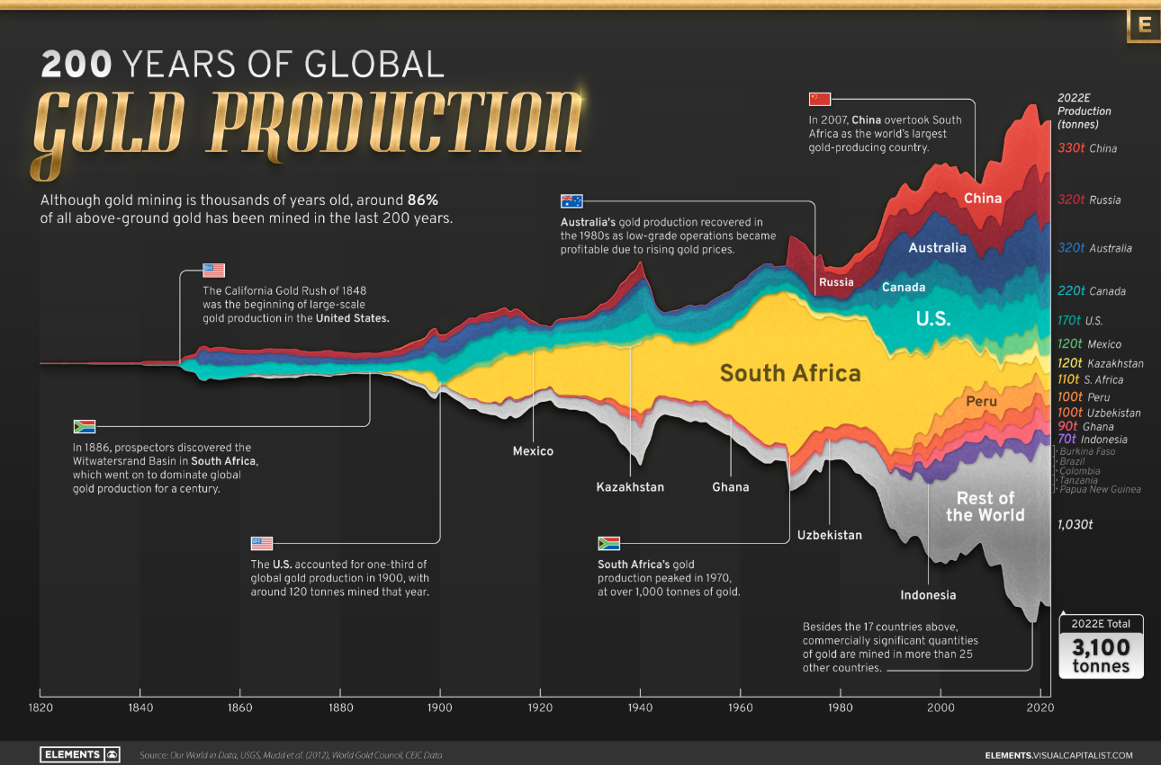

Slide 23
Rare earth elements

Slide 24
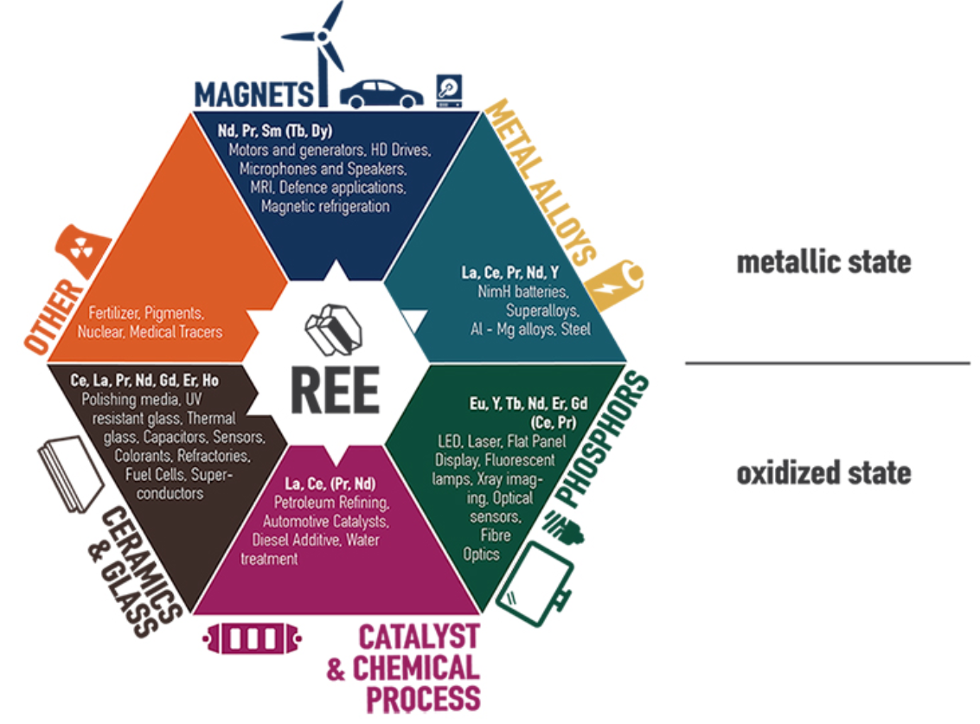
https://www.eurare.org/RareEarthElements.html

Slide 25
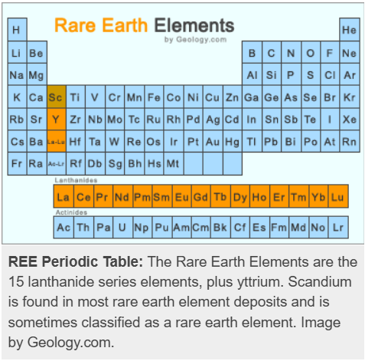
Not rare! Similar in crustal abundance to Ni, Cr, Zn, Cu etc (169.1 ppm)
Form phosphates, silicates, carbonates, oxides and halides
Rare concentrations of economically viable deposits
Light Rare Earth Elements (LREEs) = La-Eu
Heavy Rare Earth Elements (HREEs) = Y + Gd-Lu

Slide 26
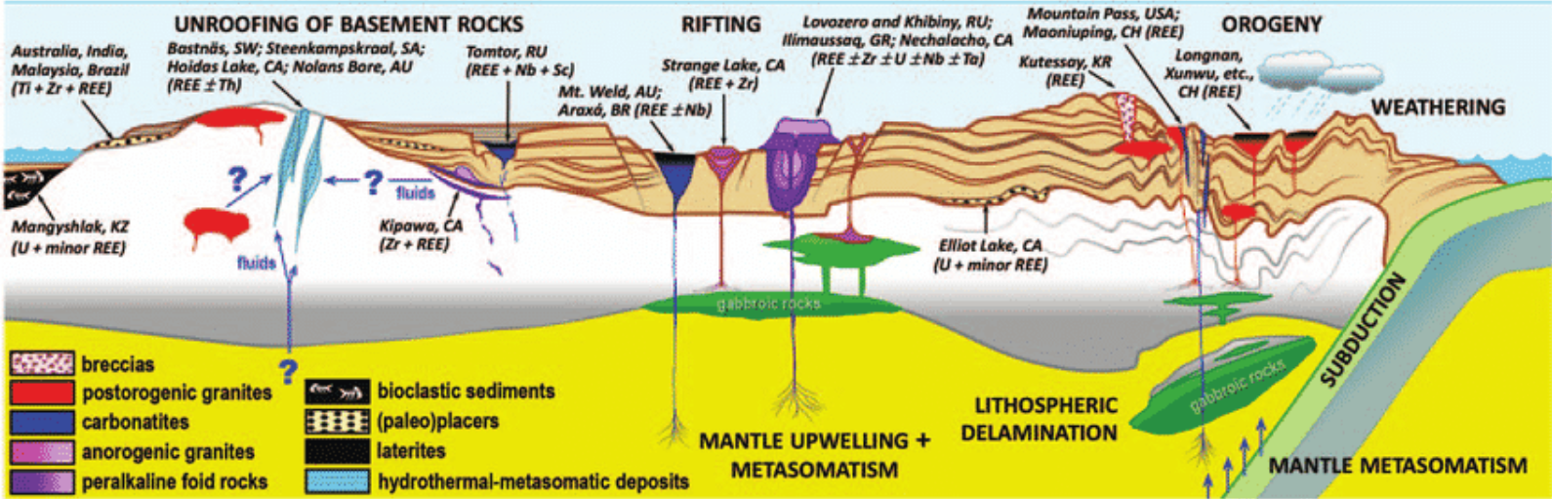
Primary deposits:
  Carbonatites e.g. Mountain Pass, USA
  Alkaline igneous rocks e.g. Lovozero, Russia
Secondary deposits (erosion of primary):
  Placer deposits e.g. IREL Mineral Sands India
  Ion adsorption clays e.g. South China Clay Deposits

Slide 27
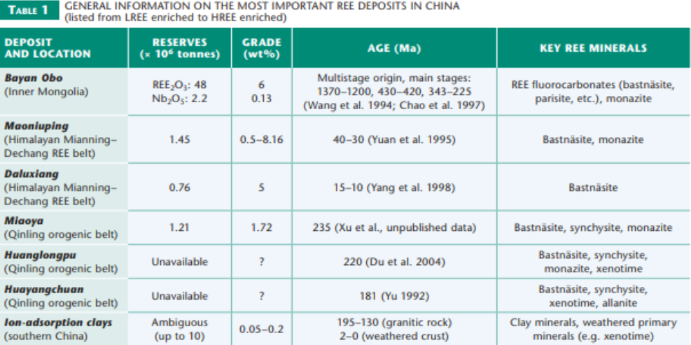
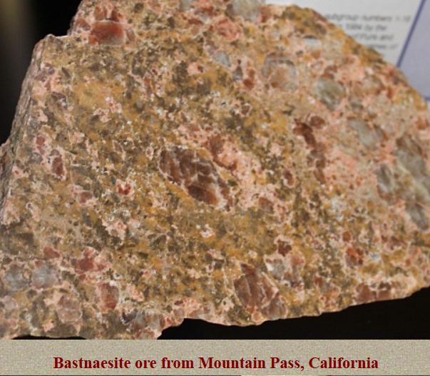
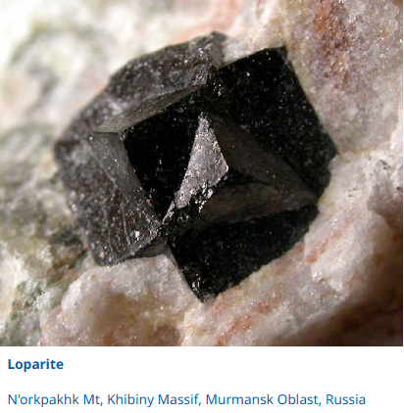
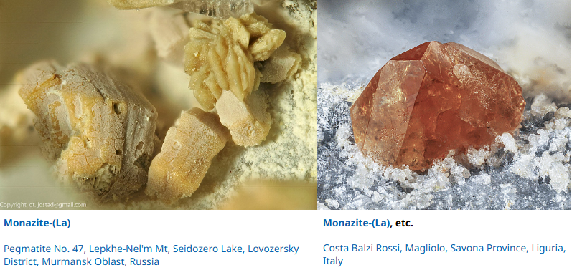
CeCO₃(OH,F)
(Na,REE)₂Ti₂O₆
La(PO₄)
https://www.elementsmagazine.org/diversity-of-rare-earth-deposits-the-key-example-of-china/

Slide 28
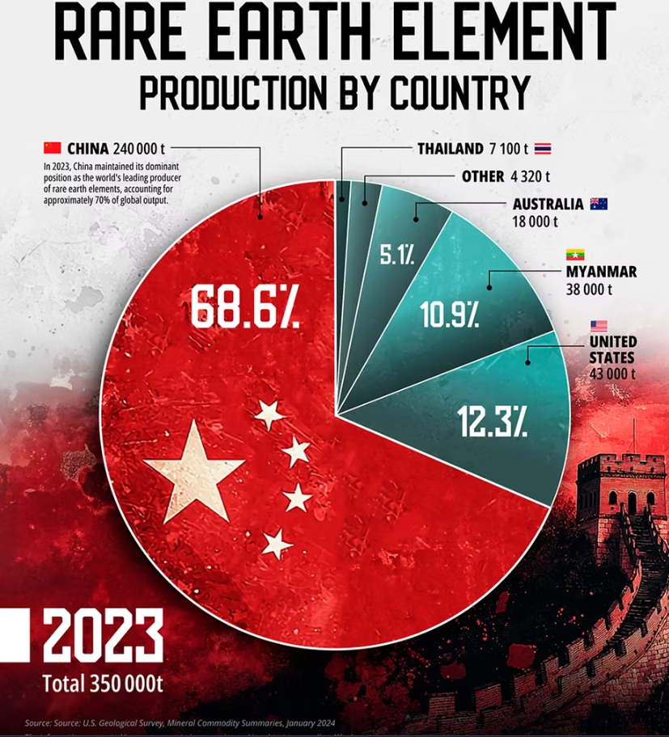

Slide 29
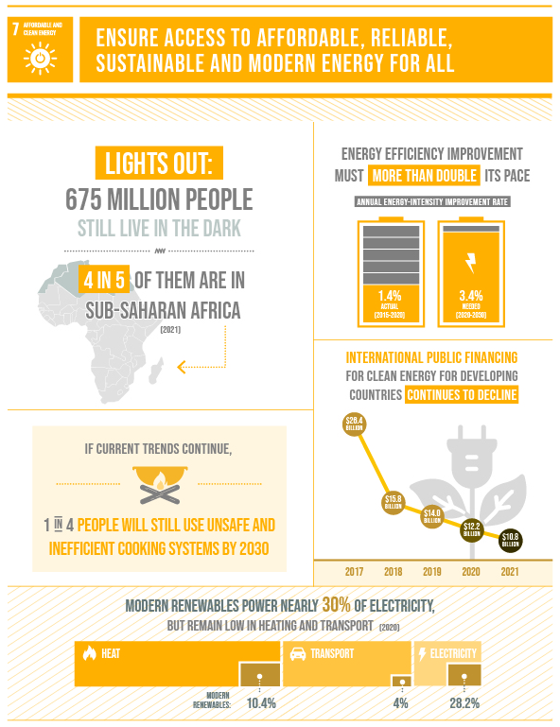
Fossil Fuels

Slide 30
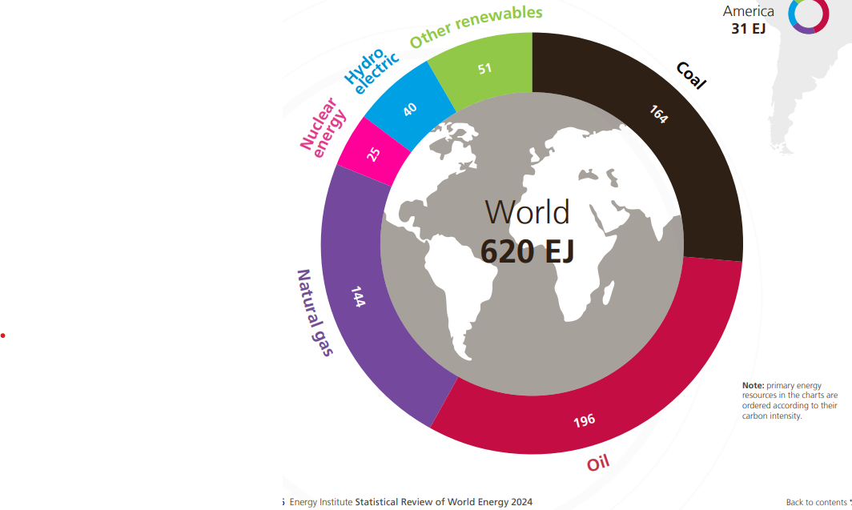
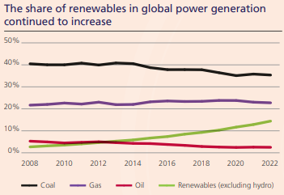
Total primary energy consumption increased by 2% over its 2022 level, 0.6% above its ten-year average and over 5% above its 2019 pre-COVID level.
Renewables’ share of total primary energy consumption reached 14.6%, an increase of 0.4% over the previous year. Together with nuclear, they represented over 18% of total primary energy consumption.
Fossil fuel consumption as a percentage of primary energy dropped 0.4% to 81.5%.
https://www.energyinst.org/statistical-review/home

Slide 31
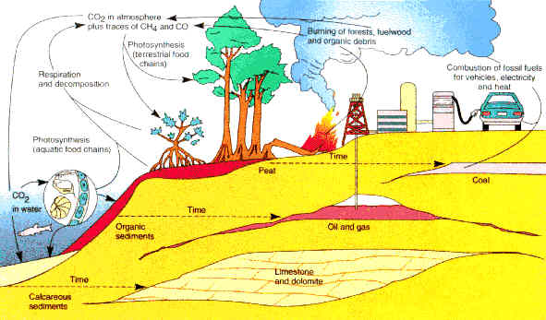
Carbon cycle
CO₂ in the atmosphere
Burning forests and organic debris
Anthropogenic carbon
Photosynthesis
Respiration and decomposition
Photosynthesis
(aquatic)
COAL
Organic sediments
OIL AND GAS
Limestone and dolomite
Calcareous sediments
http://www.astraea.net/aboutimages/co2.jpg

Slide 32
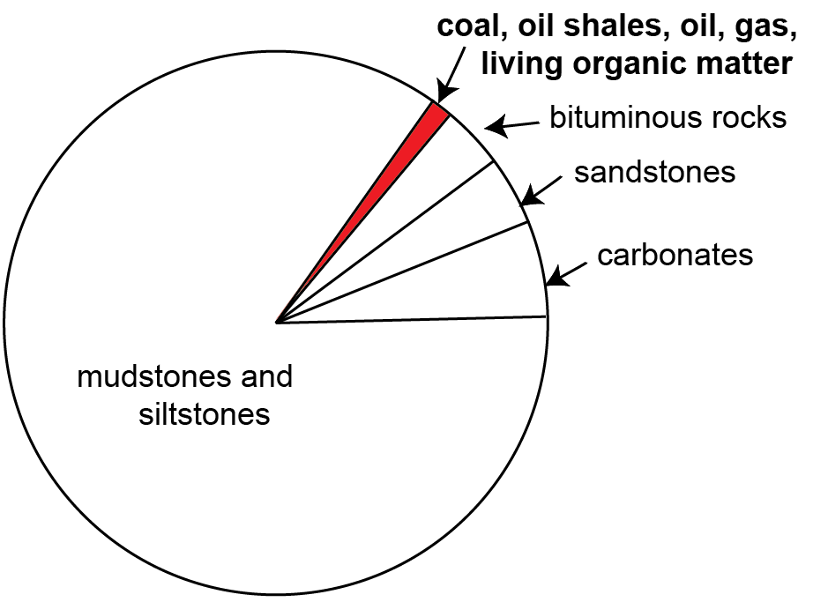
Fossil fuel creation
Fossil fuels are created as atmospheric CO₂ formed into organic matter (C, H, O)
1% (est.) of the total organic matter is preserved through burial in sediments

Slide 33
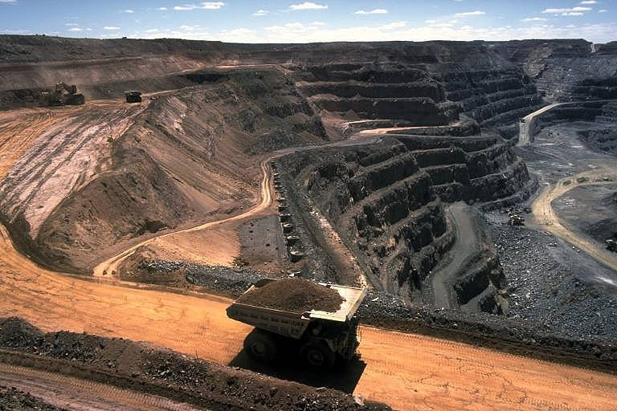
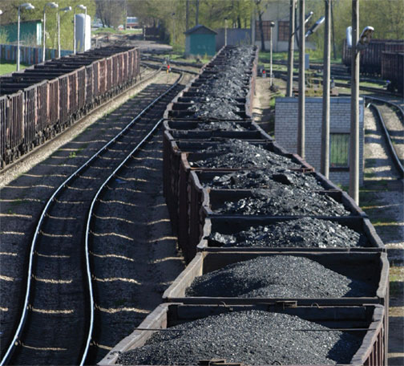
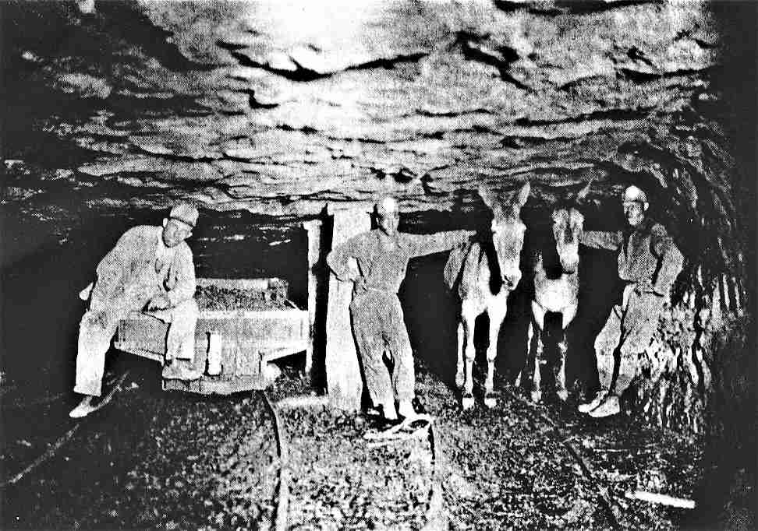
Coal

Slide 34
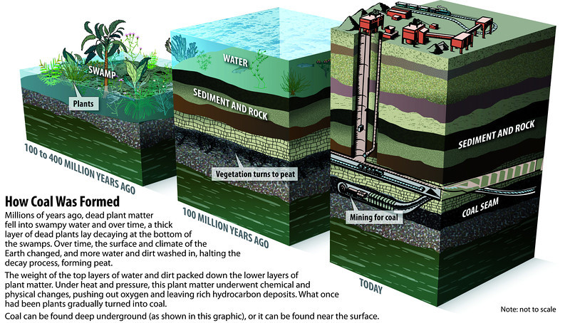
Coal formation
http://need-media.smugmug.com/Graphics/Graphics/17024036_Bdmf8C/1295824178_2JgX3xW#!i=1295824178&k=2JgX3xW

Slide 35
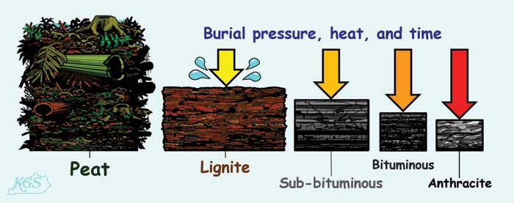
Humic coal ranks
Only ~10% of organic matter preserved during peat forming conditions
Leaves behind large hydrocarbon molecules
Increase in C content, decrease in H and O content
http://www.uky.edu/KGS/coal/coalkinds.htm

Slide 36
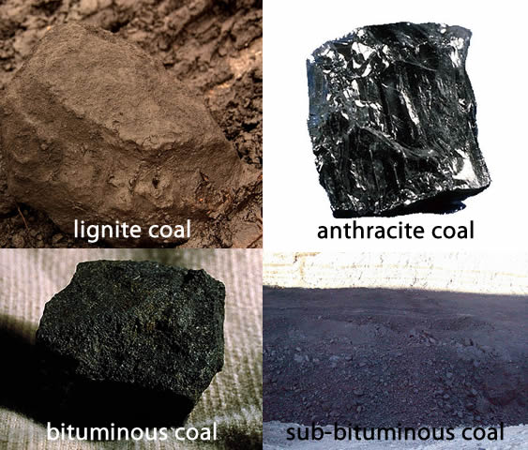
LIGNITE
25-35% Carbon
4,000-8,300 Btu/lb
ANTHRACITE
86-97% Carbon
~15,000 Btu/lb
BITUMOUS
45-86% Carbon
10,500-14,000 Btu/lb
SUB-BITUMOUS
35-45% Carbon
8,300-11,500 Btu/lb
Consist of ‘macerals’ the coal equivalent of minerals in rock formation
https://www.e-education.psu.edu/eme444/node/270

Slide 37
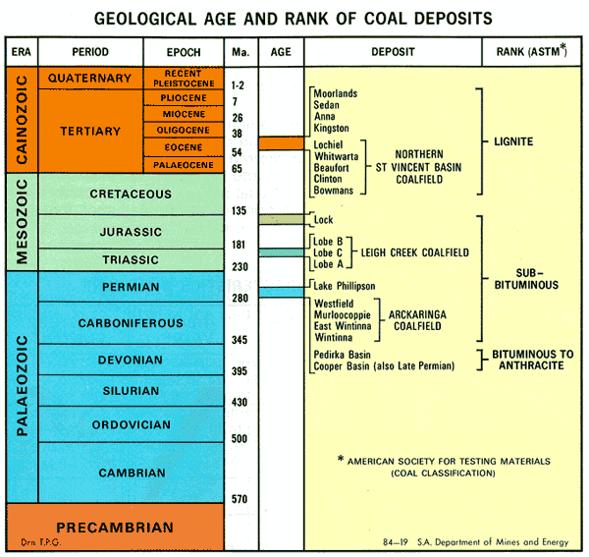
Age of Coal

Slide 38
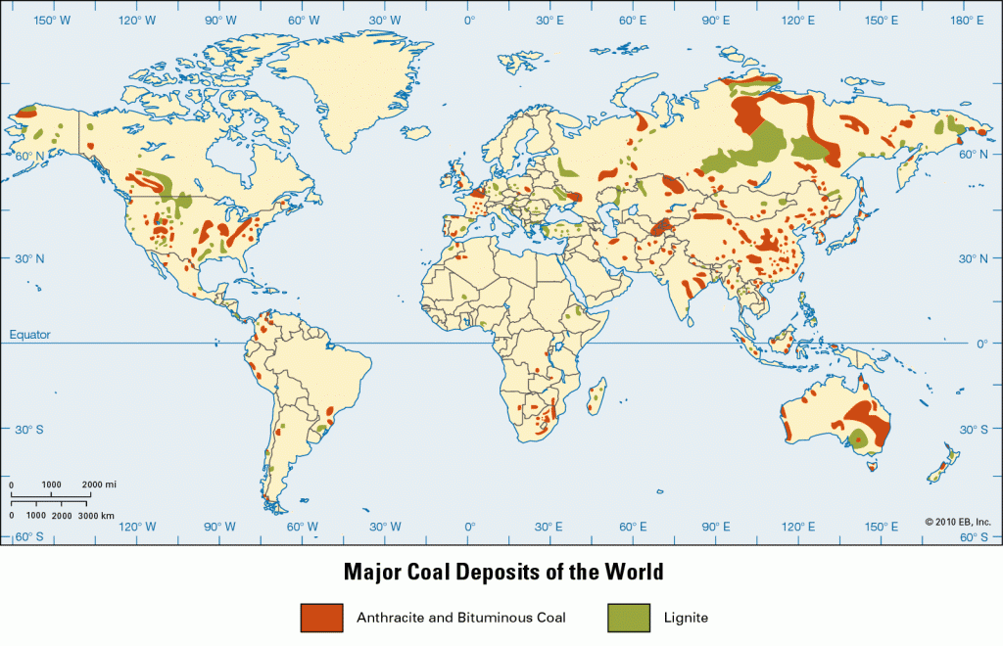
COAL
http://firesideresearch.org/renewable-energy-technologies-for-electricity-generation-in-sub-saharan-africa-part-i/

Slide 39
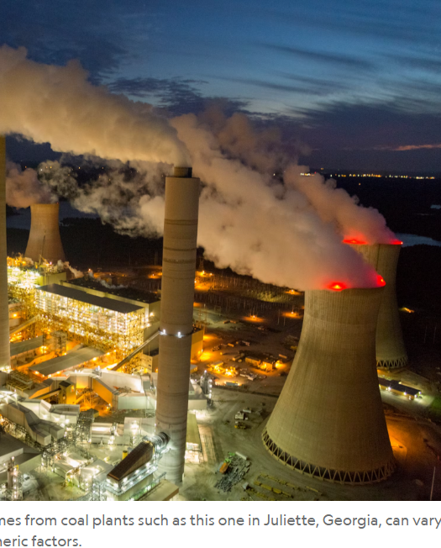
Impurities pollution
Clay minerals and other non-combustibles = ash
Carbonate minerals e.g. Fe carbonate
NH₄ N₂O, NO, NO₂
H₂S and FeS₂ SO₂
NaCl –causes corrosion in boiler plants
Trace elements e.g. Ge, As, U

Slide 40
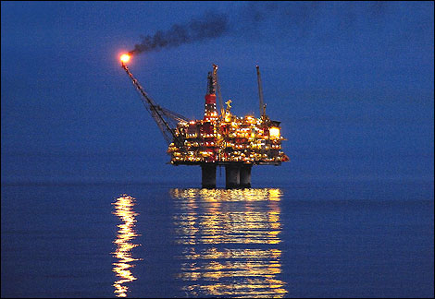


OIL AND GAS

Slide 41

Oil and gas formation
https://vle.whs.bucks.sch.uk/mod/page/view.php?id=65176

Slide 42

Planktonic microorganisms

Slide 43

50°C/
up to 300m
Up to 150°C /
1500 atm/
3.5-5 km
Metagenesis
Below 4 km/
Above 1500 atm/
Above 150°C

Slide 44

Oil and
gas formation
with temperature

Slide 45

Average accumulation rates over geological time
https://www.researchgate.net/publication/228663031_Exponential_growth_energetic_Hubbert_cycles_and_the_advancement_of_technology

Slide 46


Natural gas is >99% methane (CH₄), with minor ethane (C₂H₆), propane (C₃H₈), butane (C₄H₁₀), plus CO₂, H₂S, N₂, H₂, NH₃
  Terrestrial or marine environments
Petroleum is a mixture of numerous hydrocarbon compounds (basis for lubricants, plus >7000 organic compounds, plus “petrol”)
  Marine environments

Slide 47

Simple oil and gas trap

Slide 48


Source rock e.g. Kimmeridge clay
Jurassic in age
Major source rock for the North Sea

Slide 49

Typical Source Rock

Slide 50
Reservoir rocks
Require the following properties:
Porosity
Void space as opposed to solid phase within a rock The void space maybe infilled by either fluids (e.g. oil, brine, etc) or gasses (e.g. atmosphere, hydrocarbons or gas).
    Pettijohn et al. (1972)

Slide 51
Permeability
the relative ability of a material (rock) to transmit fluids through connected pore space
Rocks with similar porosity do not necessarily have the same permeability

Slide 52


Blue-dyed thin section illustrating a reservoir rock
Sandstone: void space (porosity) enclosed by solids
Notes:
Sandstone

Slide 53


Seal
Seals are rocks that significantly reduce the onward migration of fluids in the subsurface
Best seals have the following attributes
  Small pore sizes
  Ductile rocks (to resist fracturing)
  Thick rock units with wide lateral extents
  Best seals are mudstones, evaporites, chalk and crystalline lithologies
Evaporite-halite
mudstone

Slide 54

Oil and gas formation

Slide 55

World Sedimentary Basins
Green = onshore sedimentary basins
Purple = offshore sedimentary basins

Slide 56

Oil discoveries past and future
Declining

Slide 57

Peak Oil
Oil discovery in the world peaked in the 1960s
Production is or has peaked around now
Today we consume approx. 4x as much as we discover
Oil will not run out soon, good quality, easy to extract oil will however..

Slide 58

The global natural gas resource base is vast and widely dispersed geographically. Conventional recoverable resources are equivalent to more than 120 years of current global consumption, while total recoverable resources could sustain today's production for over 250 years
International Energy Agency in 2012

Slide 59



Extraction

Slide 60

e.g. Offshore Platforms – Gulf of Mexico, USA.

Slide 61

Primary oil recovery = gusher

Slide 62

Secondary
Recovery

Slide 63


Nodding Donkeys.

Slide 64

Enhanced oil recovery
http://www.reservoirengineers.com/

Slide 65


Oil Refining
Fractional distillation
Heating of crude oil to higher temperatures to condense into liquid to form useful hydrocarbons

Slide 66

Natural Gas
Gas industry began with gas distilled from coal- commercial companies (London 1812; Baltimore 1816)
Modern gas industry dominated by natural gas (strong piping)
Makeup of natural gas 80-99% methane

Slide 67


Piped from wells to process plants
  remove S, H₂O, add “gas” smell
  transmit via high pressure lines (24 km/h)
  Distant sources- liquefy by cooling (-162°C; 1/600 volume) and transport in ships

Slide 68
Unconventional Fossil Fuels
OIL-BASED
  Oil (tar) sands
  Oil shales
GAS-BASED
  Coalbed methane
  Shale gas

Slide 69




Oil (tar) Sands, e.g. in Canada

Slide 70



Oil (Tar) sand extraction

Slide 71

Oil (Tar) sand - refining

Slide 72

Oil Shales/Sands
Fine-grained rocks containing significant quantities of kerogen
Formed in swamps and shallow marine environments
Kerogen-waxy, insoluble, contains a mixture of heavy hydrocarbons, can be converted to oil by heating above 500°C
Major oil shales are in USA and Russia

Slide 73

Coalbed methane
CBM is extracted by releasing pressure in coal seams, usually by natural gas production or by pumping water from the coal bed. As the pressure is reduced, gas is released and can be extracted.
Most of the gas is adsorbed on the surface of the coal: it can contain two to three times more gas per unit of rock volume than conventional gas deposits.

Slide 74

Shale gas
Shale gas is extracted from "source rock“ - has naturally low permeability.
The gas is held in fractures, pore spaces and adsorbed on to the organic material of shale.
‘Crack’ the rock using hydraulic fracturing method 'fracking'.
Fracturing fluid, a combination of water and sometimes chemicals, is pumped at high pressure into the rock to create narrow fractures that allow the gas to flow

Slide 76


Paper of the week

Slide 77
Justification
In 2015 the Paris Agreement and the Intergovernmental Panel on Climate Change (IPCC) refocused the debate on warming limits of 1.5 °C
Extends the earlier 2015 work to estimate the levels of unextractable fossil fuel reserves out to 2100 under a 1.5 °C scenario
Fossil fuels continue to dominate energy
COP26 2021: Secure global net zero by mid-century and keep 1.5 degrees within reach

Slide 78

Unextractable oil, fossil methane gas and coal reserves are estimated as the percentage of the 2018 reserve base that is not extracted to achieve a 50% probability of keeping the global temperature increase to 1.5 °C.

Slide 79

AFR=AFRICA CSA=CENTRAL AND SOUTH AMERICA FSU=RUSSIA AND FORMER SOVIET STATES
MEA=MIDDLE EAST USA=UNITED STATES OF AMERICA

Slide 80
Conclusions
Bleak picture painted by the scenarios for the global fossil fuel industry
Likely an underestimate, therefore more carbon needs to stay in the ground.
Relies on Carbon capture of approximately 4.4 (5.9) GtCO2 per year by 2050 (2100).
Discuss the drivers and possible solutions to reducing fossil fuel dominance
Do you think that we will succeed with the aim of 1.5degC?
Discussion

